Slide 1
MLH 2.0 Usability Testing Results
January 2022
A resource from MichiganLegalHelp.org

Slide 2
Overview
171 completed tests!
Guide to Legal Help/LiveHelp survey: 30 (1)*
Toolkit intro design survey: 30 (1)*
Card sorts (two linked tasks)
Housing: 30 (11)*
Family: 25 (14)*
Toolkit layout tasks (two linked tasks)
First click test for divorce info: 30 (3)*
Survey about toolkit layouts: 26 (17)*
There is some drop off with linked tasks, and when they are linked we have to end the linked task when the first hits the set number. This is ok, but just something to note for future planning
*Abandoned = started a study but exited before getting to the final page. I’m not sure if the high abandon rates mean anything. This will be something to look at in future UX.
https://michiganlegalhelp.org/help-us-improve-michigan-legal-help

Slide 3
We surveyed people to ask how the felt about a Guide to Legal Help popup, and then asked follow up questions to ask opinions about the Guide and Chat buttons.
Test 1: Guide and LiveHelp Survey
Notes:
A friend or family member served the document. They can do this by registered or certified mail, or by personal service (handing someone the papers)

Slide 4
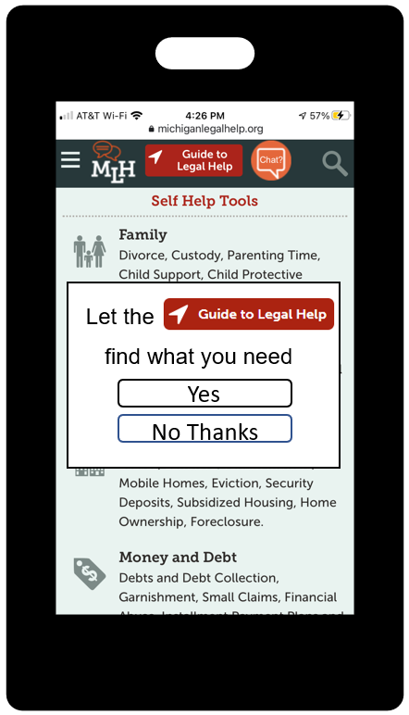
Question 1: How Likely Are People to Click the Guide Popup?

Slide 5
Question 1: How Likely Are People to Click the Guide Popup?
Imagine you use a smartphone and go to MichiganLegalHelp.org. This is what you see when the website opens. How likely would you be to click "Yes" on this screen?
Conclusions:
It probably makes sense to leave this popup in place. In addition to giving people an initial chance to opt in, it may also act as early ‘advertising’ for the Guide. More on this later.

Slide 6
Question 2: Do People Connect the Guide Popup with the Guide Top Banner?

Slide 7
Question 2: Do People Connect the Guide Popup with the Guide Top Banner?
Even if you would have clicked "Yes," imagine you clicked away and decided to look around the website to find what you needed. You decide that you actually would like the help that the popup offered. Where on the screen would you click first to try to find this?
Conclusions:
People seem to make some connection between the Guide popup and the Guide at the top of the screen. Maintaining visual branding for the Guide seems worthwhile.

Slide 8
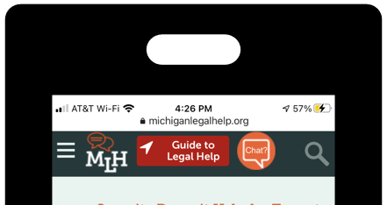
Question 3: Looking at the Top Banner, What Do People Expect the Buttons to do ?

Slide 9
Question 3: Looking at the Top Banner, What Do People Expect the Buttons to do ?
What do people think the Guide to Legal Help button does?
Conclusions:
I was very generous in my interpretation of “sort of described the Guide,” but still, people seem to basically know what to expect here.

Slide 10
Question 3: Looking at the Top Banner, What Do People Expect the Buttons to do ?
What do people think the Guide to Legal Help button does?
Conclusions:
People know what the chat button does! I didn’t really have to give many generous interpretations here, people knew what to expect. More broadly I think this might be an example of a place where it pays to copy other website trends. People know exactly what this does because they are used to seeing it on other websites.

Slide 11
Question 4: Do People Prefer the Guide or the Chat Button for Help?

Slide 12
Question 4: Do People Prefer the Guide or the Chat Button for Help?
If you needed help finding information, would you be more likely to click the red "Guide to Legal Help" button or the orange "Chat?" button?
Conclusions:
People preferred the Guide even though there was a little less certainty about what it does. Even though they can’t describe it, people seem to like finding things on their own through a web guide over interacting with a live agent. There are still a strong minority of people who would choose chat so both are important.

Slide 13
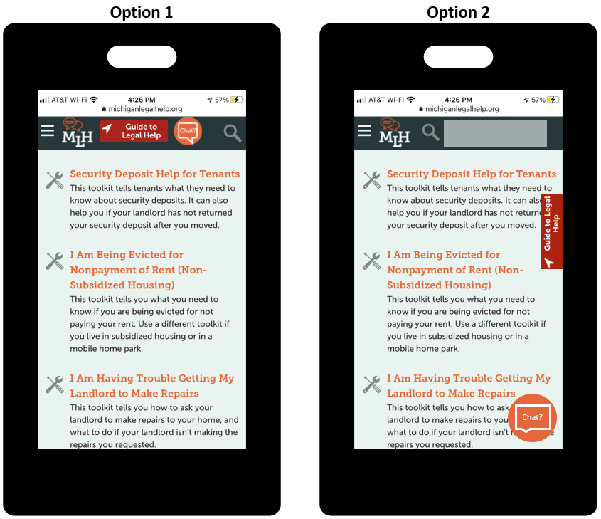
Question 5: What Button Placements Do People Prefer?

Slide 14
Question 5: What Button Placements Do People Prefer?
Conclusions:
This call is closer than some of the others. I worried when putting this task together whether I adequately conveyed that the buttons would float and should not really obstruct content. I wonder if this outcome would be different if we gave people actual screens to scroll?
I think going with either option could be fine in MLH 2.0 and we should consider this data in conjunction with our needs to have places for occasional (but increasingly frequent) other banner items.
There was a bit of an age break here. Everyone who chose the floating buttons was 50 or under, and every single participant who was 51 or older chose the static buttons.

Slide 15
We drafted a set of second-level headings for Housing and Family. We gave people an assortment of content titles and asked them to sort each title into the category where they would look for it. They were required to sort each card, but there was a category for “I’m not sure.”
Test 2: Family and Housing Card Sorts
Notes:
A friend or family member served the document. They can do this by registered or certified mail, or by personal service (handing someone the papers)

Slide 16
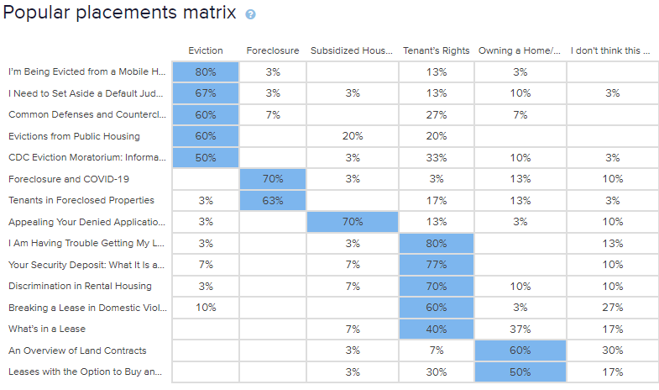
Housing
Notes:
Lots of overlap in eviction/tenants rights/owning a home. Perhaps regrouping into (1) Rental Housing: Materials for Landlords and Tenants and (2) Homeownership and Foreclosure? OR Breaking the Lease stuff into stages. (1) Leases and Issues During a Tenancy (better name?) (2) Eviction (3) Security Deposits. Owner side things would include (1) Buying a Home (2) Foreclosure

Slide 17
Family
Notes:
There was the most confusion surrounding CPS cases, which is expected because it is not a great fit anywhere. There is a good bit of overlap between custody and parenting time/paternity and parentage, and giving a non-parent legal power over a child.

Slide 18
We gave people the same legal problem twice, with two different screen layouts. We wanted to test where they would click first for information, which set-up they preferred, and how quickly they could find the information they needed.
Test 3: First Click Testing & Layout Question

Slide 19
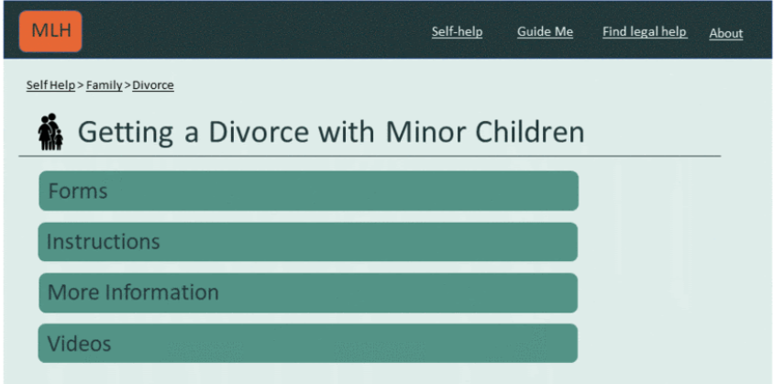
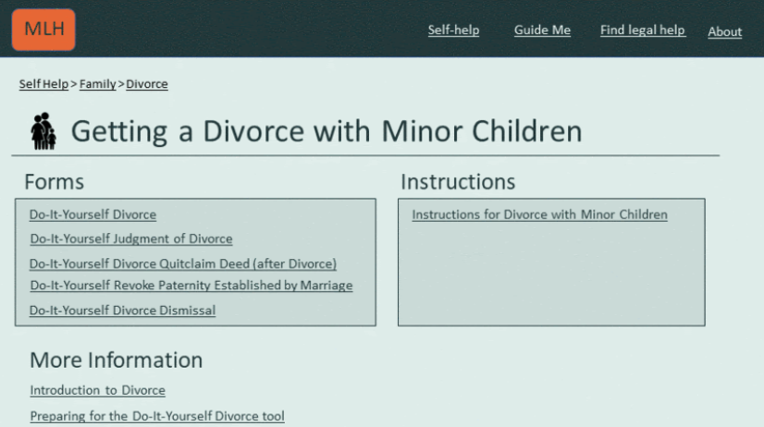
Scenario: Imagine you were visiting a website with legal information and you had questions about divorce. In this scenario, you have one 19-year-old child and you are wondering if you will need to pay child support. Where would you click first to look for this?
Users were given screen A first, and then asked the same question for screen B.
Screen A
Screen B

Slide 20
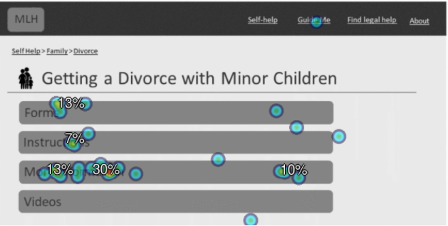
Screen A
Clicked Areas:
More Information: 57%
Forms: 17%
Instructions: 10%
Guide Me: 3%
Failure (Not in a recognized, clickable area): 13%
Median Click Time:
14.08 seconds
Fastest: 0.28
Slowest: 71.14

Slide 21
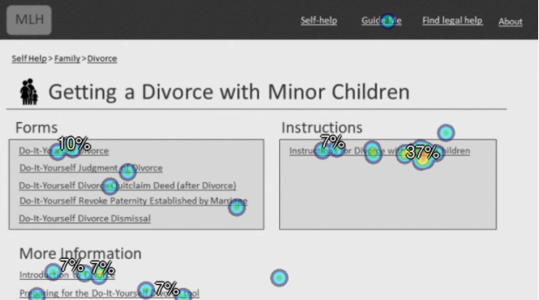
Clicked Areas:
Instructions for Divorce with Minor Children: 37%
Introduction to Divorce: 13%
Preparing for DIY Divorce: 10%
DIY Divorce: 10%
DIY Revoke Paternity: 3%
DIY Quitclaim: 3%
DIY Judgment of Divorce: 3%
Guide Me: 3%
Failure (Not in a recognized, clickable area): 17%
Screen B
Median Click Time: 25.93 sec
Fastest: 9.81
Slowest: 81.38

Slide 22
Layout Question: If you were visiting a page for legal information and the following categories were available, what order do you think they should be on the page?
Users were given three boxes: Forms, Instructions, and More Information. They were asked to drag each box into first, second, or third place.

Slide 23
Conclusions & Thoughts for Future Testing
Users spent less time searching for information on Screen A.
Users preferred a layout that had Information first, then Forms, and then More Information. This appeared to be true even if users picked “More Information” when they wanted to learn about a specific legal problem earlier on in the first-click test.
For future click testing, may need to expand “clickable” areas to reduce the failure rate.

Slide 24
We asked users three questions about different designs to see which ones they preferred. Some questions focused on design and others focused on the amount of initial information provided.
Test 4: Preference Test

Slide 25
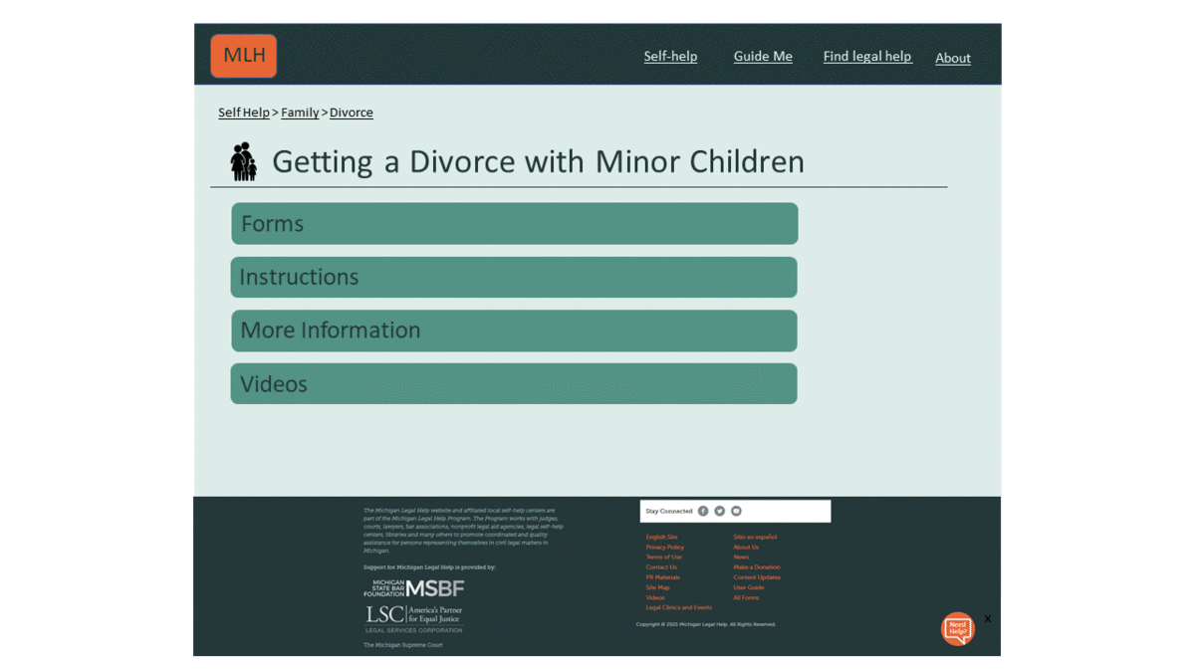
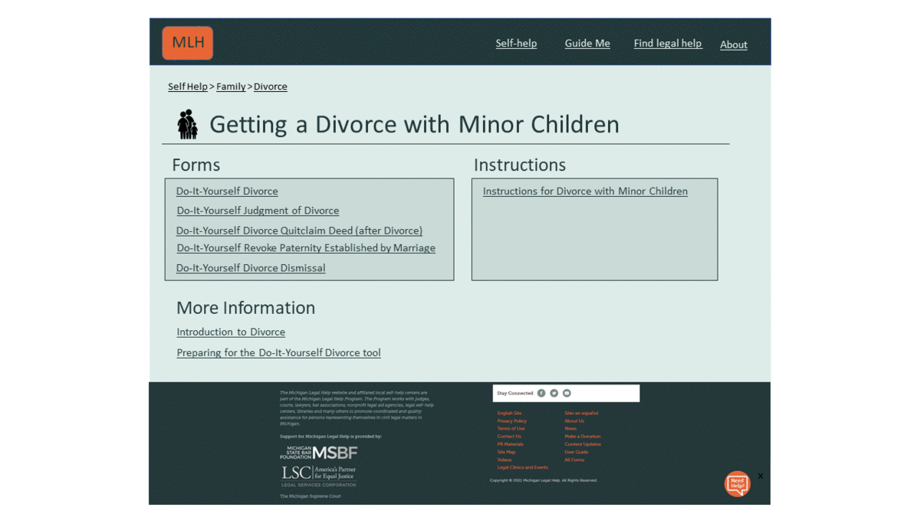
Question 1: If you were doing research on getting a divorce with minor children, which of these layouts would you prefer? Please note that the images below are animated to show what would happen if you click or scroll.
Screen A
Screen B
66.7% of users preferred
Screen A
33.3% of users preferred
Screen B

Slide 26
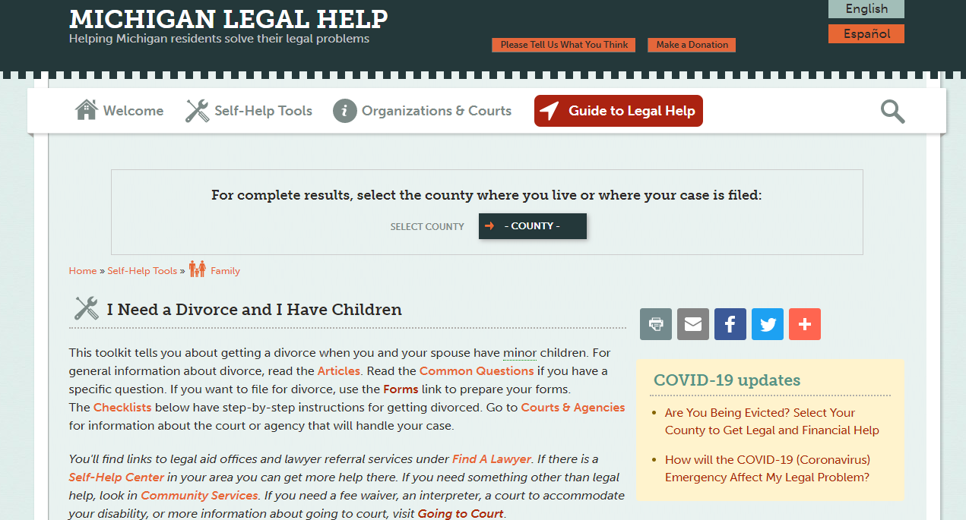
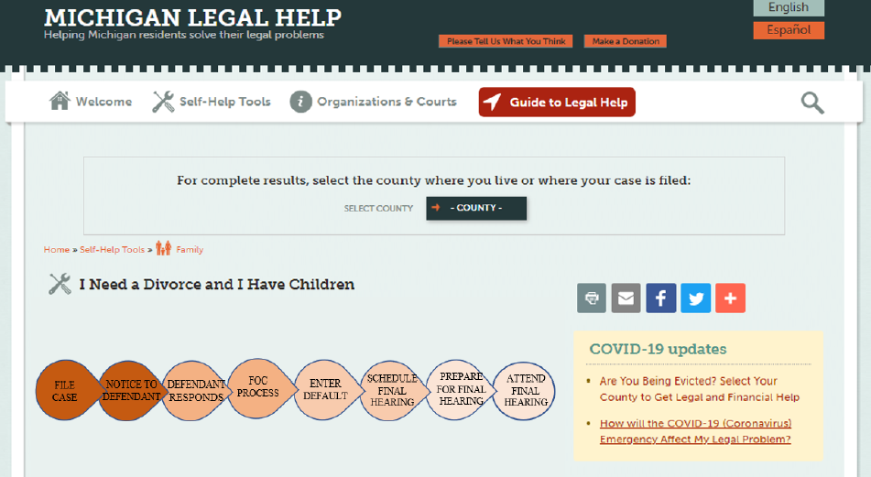
Question 2: If you were doing research on getting a divorce with minor children, which of these layouts would you prefer?
Introduction
Timeline
43.3% of users preferred the
introduction layout
56.7 % of users preferred the timeline layout

Slide 27
Question 3: This page has an introduction summarizing the types of information you will find on this webpage.
On this page there is no introduction summarizing the types of information you will find here.
Do you miss having an introduction? 70% of users said yes, they missed having it

Slide 28
Conclusions & Thoughts for Future Testing
Users seem to prefer a simple design with less information on the screen, based on their preferences for Screen A’s design and the Timeline look.
Even with a simple design, users still want some information or context with the timeline design.
For future testing, can use MLH 2.0 designs, crop screen to focus testing area, use more GIFs, and test mobile design preferences.

Slide 29
Demographics: Age

Slide 30
Demographics: Previous Experience on MLH

Slide 31
Demographics: How Often Do You Use a Phone to Do Things Online?
(less than once a month) (about once a month) (about once a week) (about once a day) (for almost everything)

