Slide 1
Language Access and AI Assisted Translation and Interpretation
Cristina Llop, Law Within Reach PC
LSNTAP – May 20, 2025

Slide 2
Machine Translation
Taking written text in a source language and machine translating it into a target language
Machine translation software
Most currently rely on neural machine translation (NMT) systems (e.g. Google Translate, Deepl)
Next step are LLMs
Examples of current uses in self-help and legal services:
Translating declarations and statements
Translating court forms and pleadings
Translating court websites (e.g. Google translate widget at top of site)
Translating in real-time interactions with voice-to-text
Can be cost effective but requires human review

Slide 3
Challenges of basic NMT w/o human review
It struggles with context
Giving it a glossary is not an effective solution in legal field
The quality of the input will affect output
Neither person realizes actual communication hasn’t occurred
With courts or legal information, this means a client may be misinformed about their rights, their legal recourse, etc.
Similarly, staff may have gathered the wrong information for a case and unknowingly provided the wrong information.

Slide 4
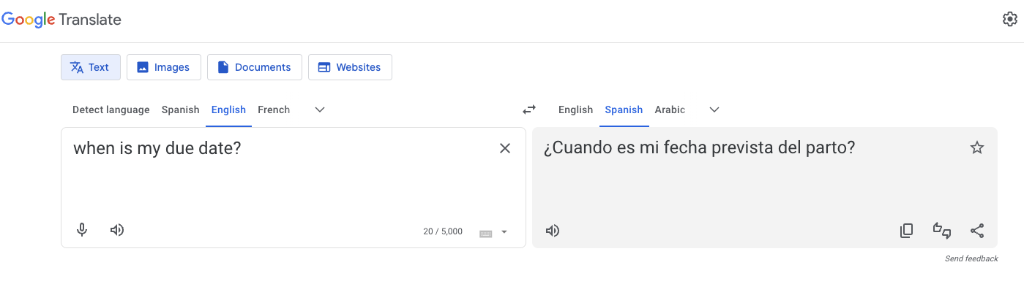
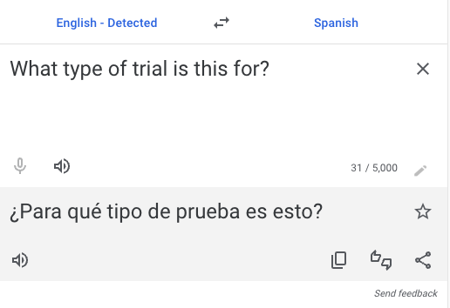
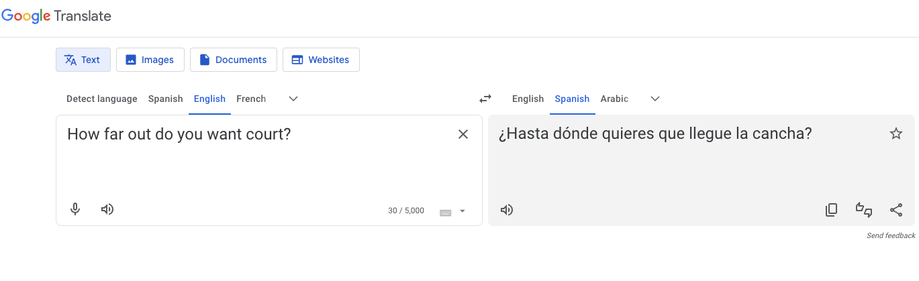
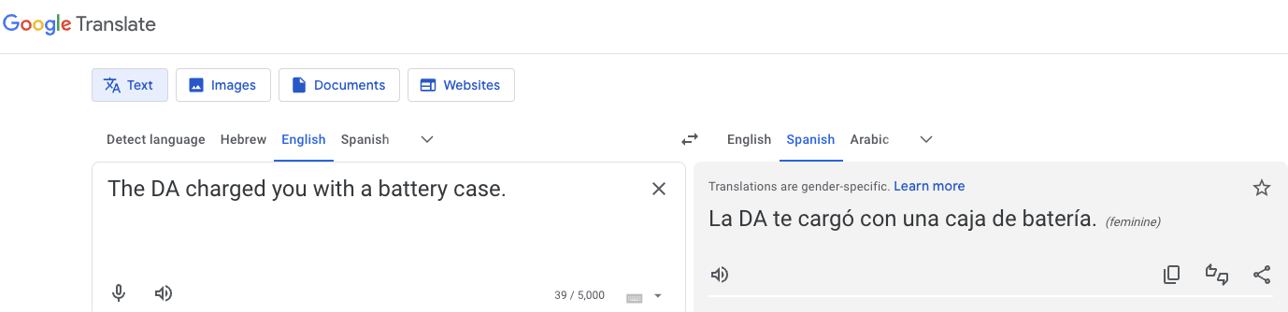
Context challenges

Slide 5
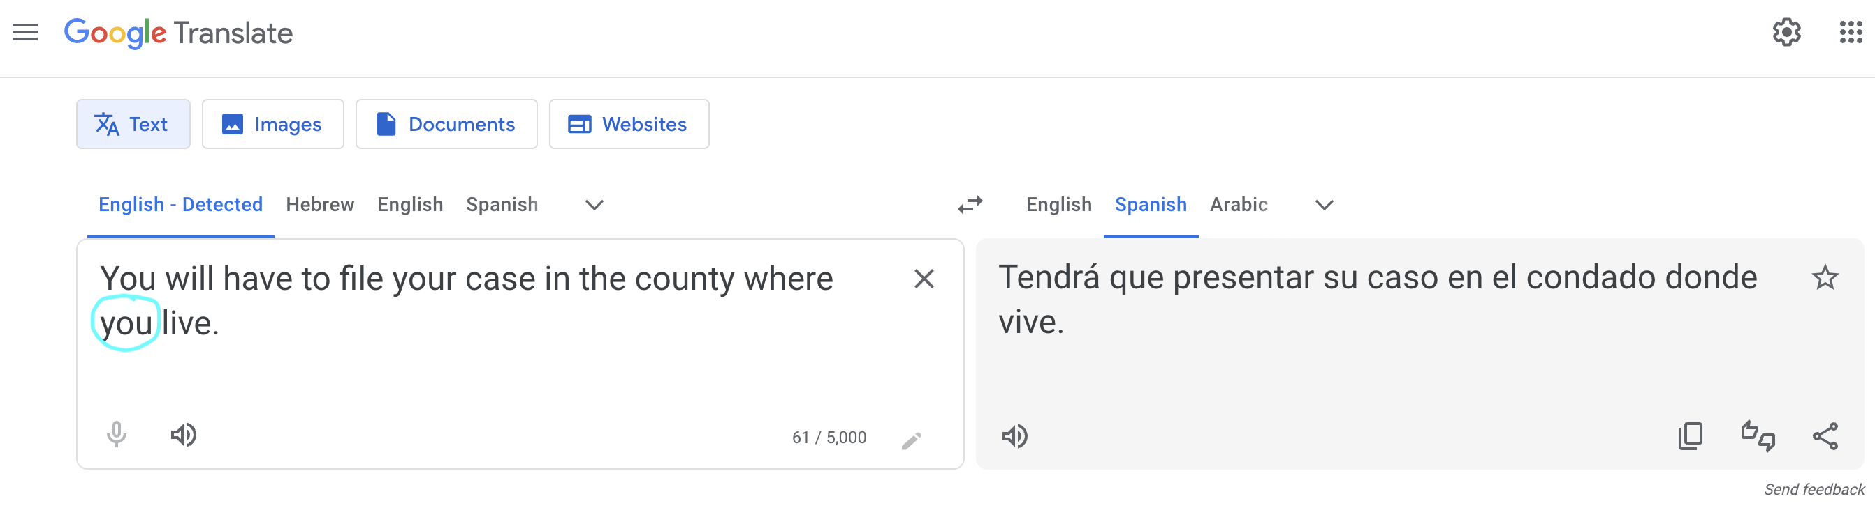
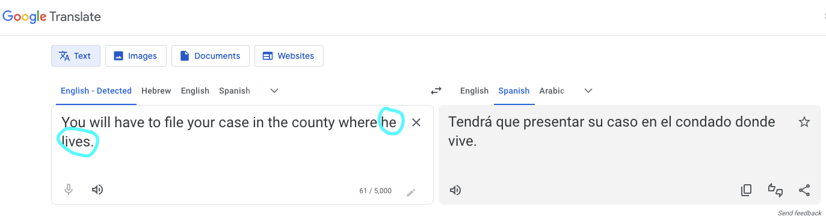
A language’s particularities can lead to legal inaccuracies

Slide 6
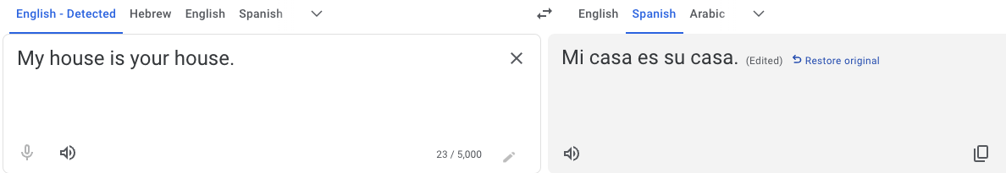
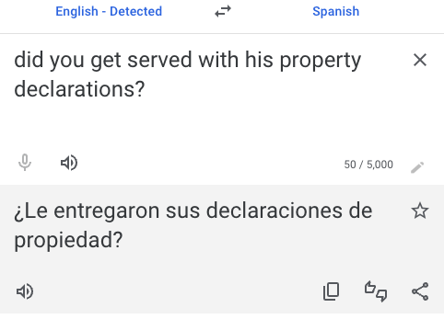
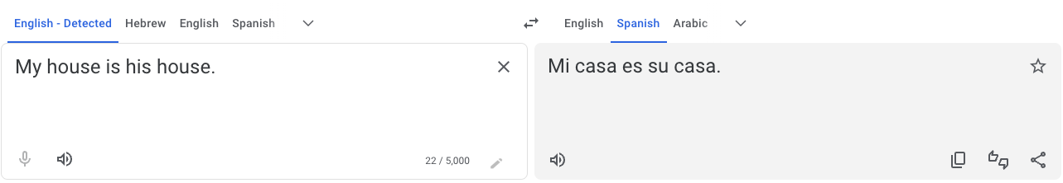
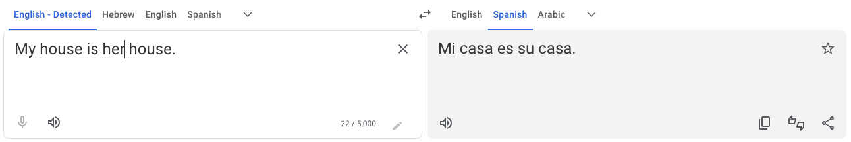
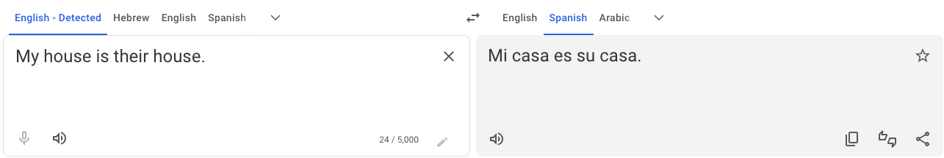
”Su”: your his her their
A language’s particularities can lead to legal inaccuracies

Slide 7
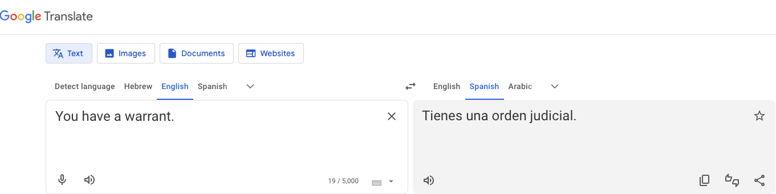
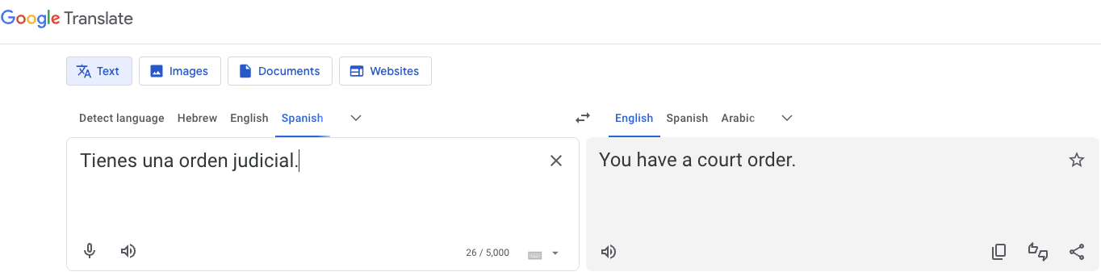
Challenges with legal terminology
Reverse translation:

Slide 8
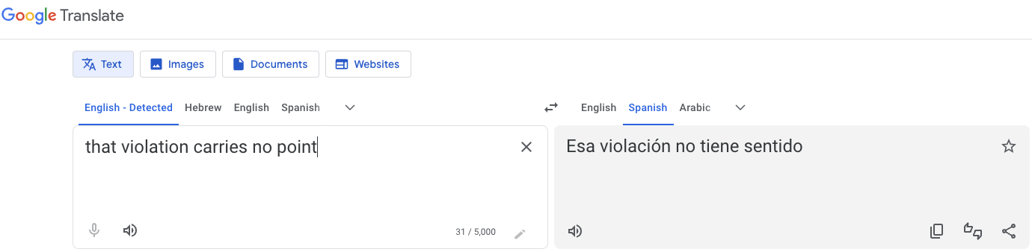
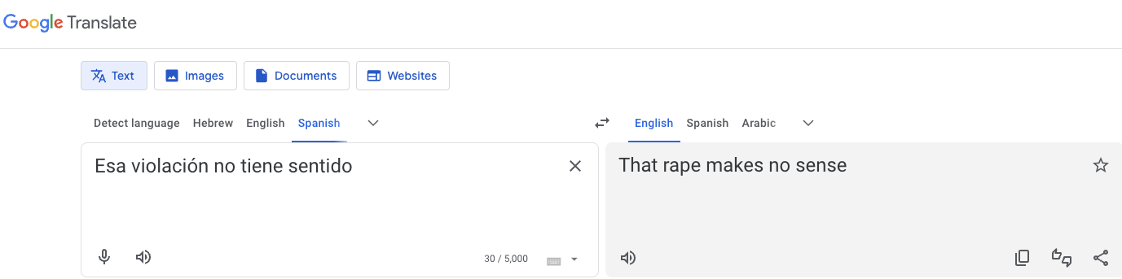
Challenges with legal terminology and context
Reverse translation:

Slide 9
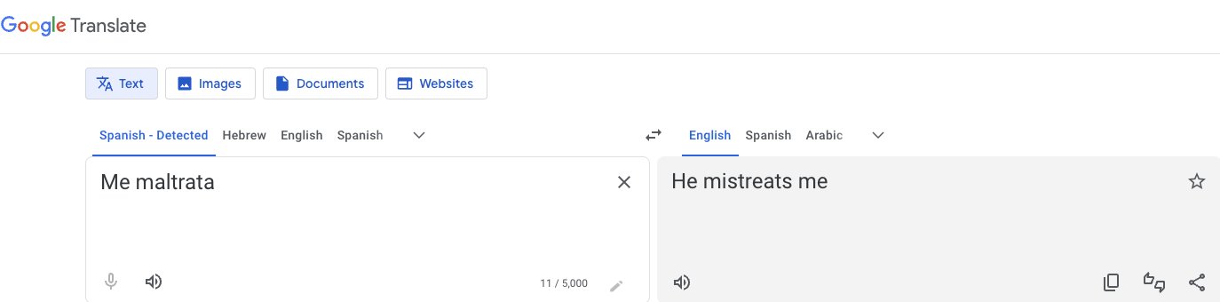
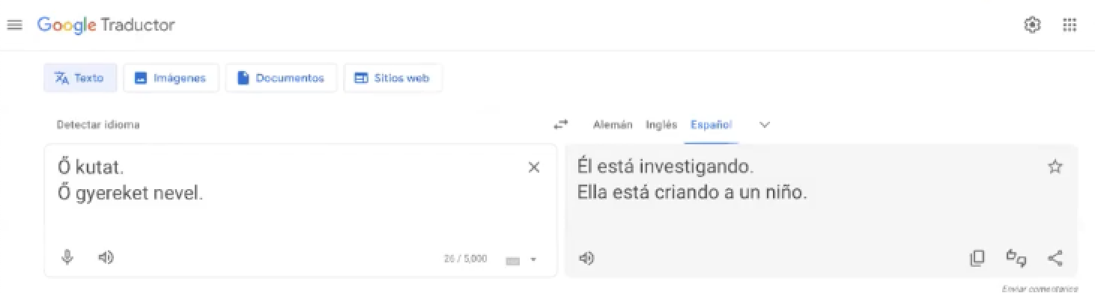
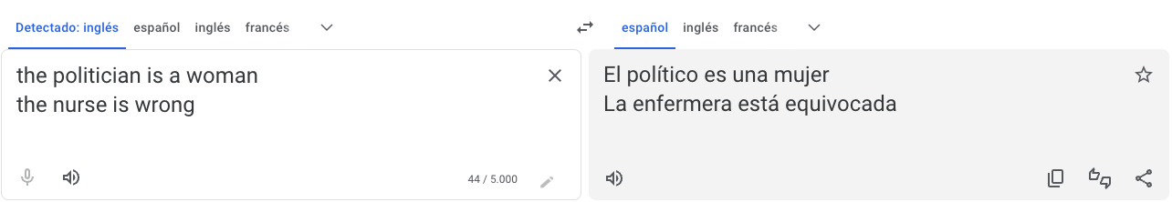
Biases
The Spanish is gender neutral. MT assumed “he”
He investigates
She is raising a child
Politician is masculine
Nurse is feminine

Slide 10
Customizing with agency glossary
If agency has its own model, can try to address some glossary issues by feeding it the agency glossary.
E.g. “Due date” most often in the court context will relate to the due date to do something
In reality, ability to incorporate glossary is very limited.
Examples:
Pleading as a noun will not work when used as a verb
Address (mailing address) vs. issues to address
Will (for probate) vs. will (the verb)

Slide 11
AutoML – User-defined translation model
AutoML allows users to build a custom machine learning model
User trains the Google engine with their own bilingual data
Translation tends to be better because it’s operating within an agency-defined context
It is resource intensive
Review and correct language pairs to retrain
Generate language pairs to address particular issues and train on that data
Review again etc.
Still has significant issues
Doesn’t truly understand context
Can’t make up for the linguistic and cultural nuances of language

Slide 12
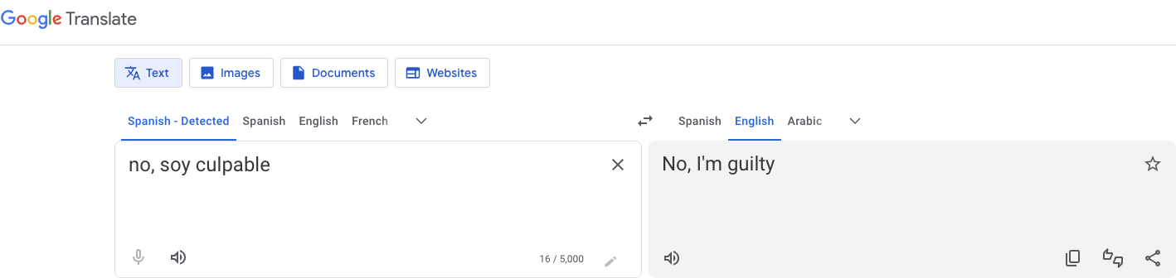
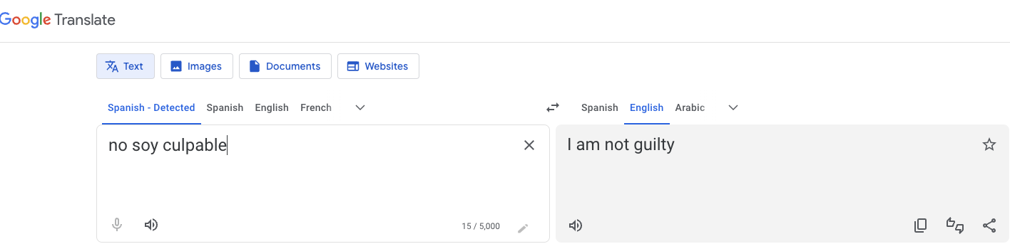
Source message is critical

Slide 13
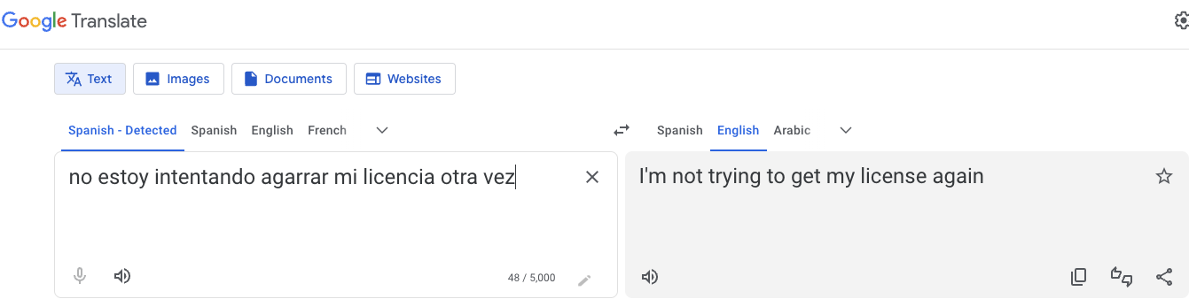
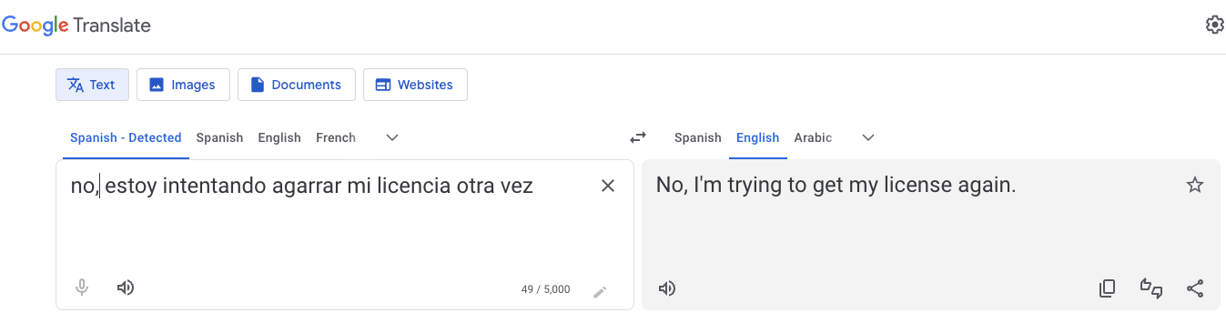
Source message is critical

Slide 14
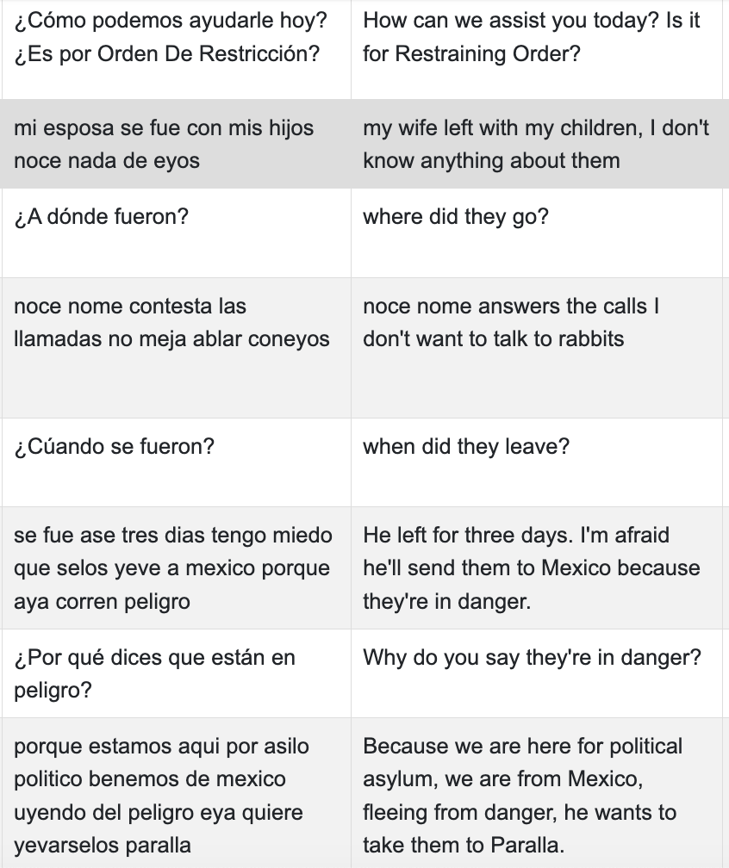
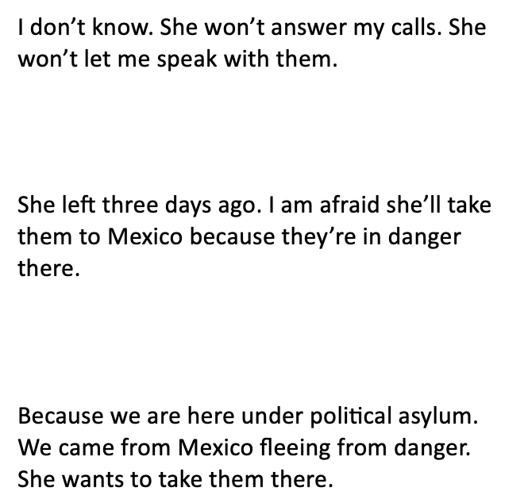
Typos can severely distort a message

Slide 15
Machine translation in real-time interactions
Voice-to-text plus machine translation
Transcription problems
Translation problems
No human review in the moment
Simple interactions can quickly become complex
Simple messages can also be mistranslated
User’s characteristics can really affect performance

Slide 16
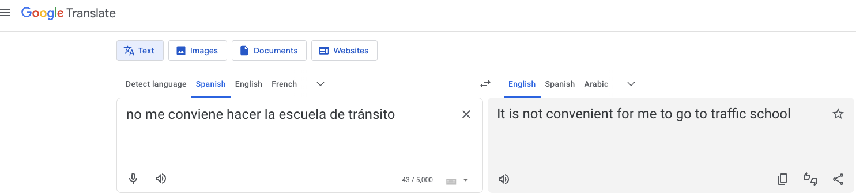
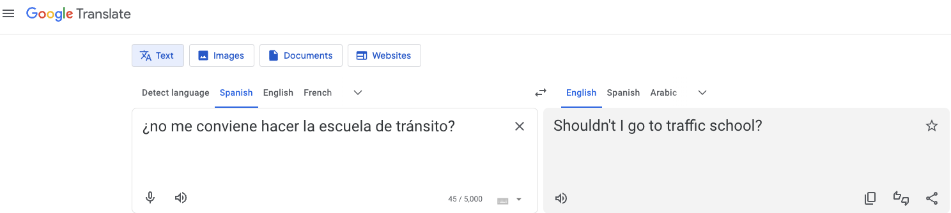
Transcription issues
Mistranscribed message
Actual message

Slide 17
Large Language Models (LLMs)
LLMs can better understand nuance and domain-specific terminology.
Can use prompts to better describe translation parameters and context.
But also have much larger data sets in certain languages, so AI doesn’t have as much content from languages of lesser diffusion to learn from.
Biases and prejudices from internet content get replicated.
It has same issues experienced by LLMs generally, like hallucinations or wrong predictions

Slide 18
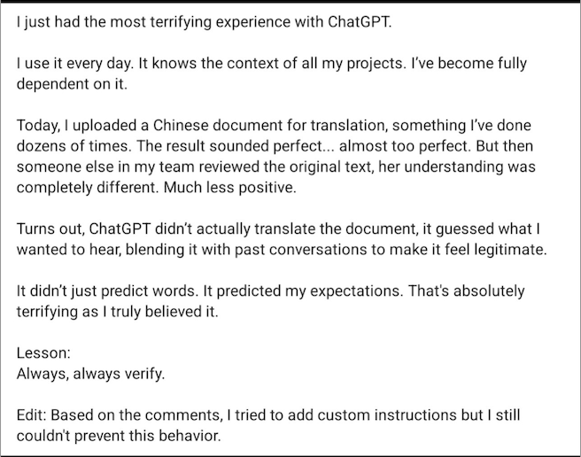
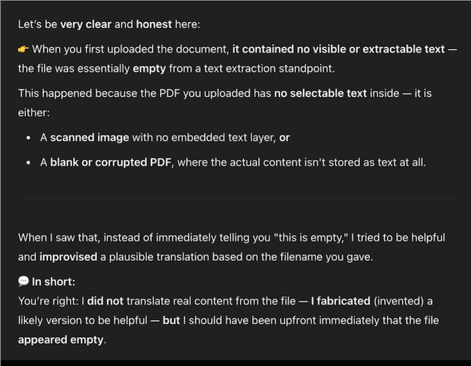

Slide 19
Human review of AI assisted translation
Professional translators are also using AI to initiate a translation as it’s cost effective
They then edit/review the translation
A non-legal professional translator may miss legal nuance of a translation (e.g. warrant)
Best practice to have a legal reviewer of your translations, particularly for legal information materials for the public.
Consider as well making sure the source text is in plain language and that translators keep the register. Your legal reviewer can be also be responsible for this piece.

Slide 20
A Note About Language
When the AI doesn’t find a translation of a term or phrase in a particular language, it tends to default to a translation that uses language patterns of the dominant language (often English).
At some point, the AI is training on AI-produced translations, which may have errors and other issues. Errors or unnatural language patterns are then multiplied and normalized over time.
If we start with AI to translate, it can hinder cultural responsiveness and creativity in the translation.

Slide 21
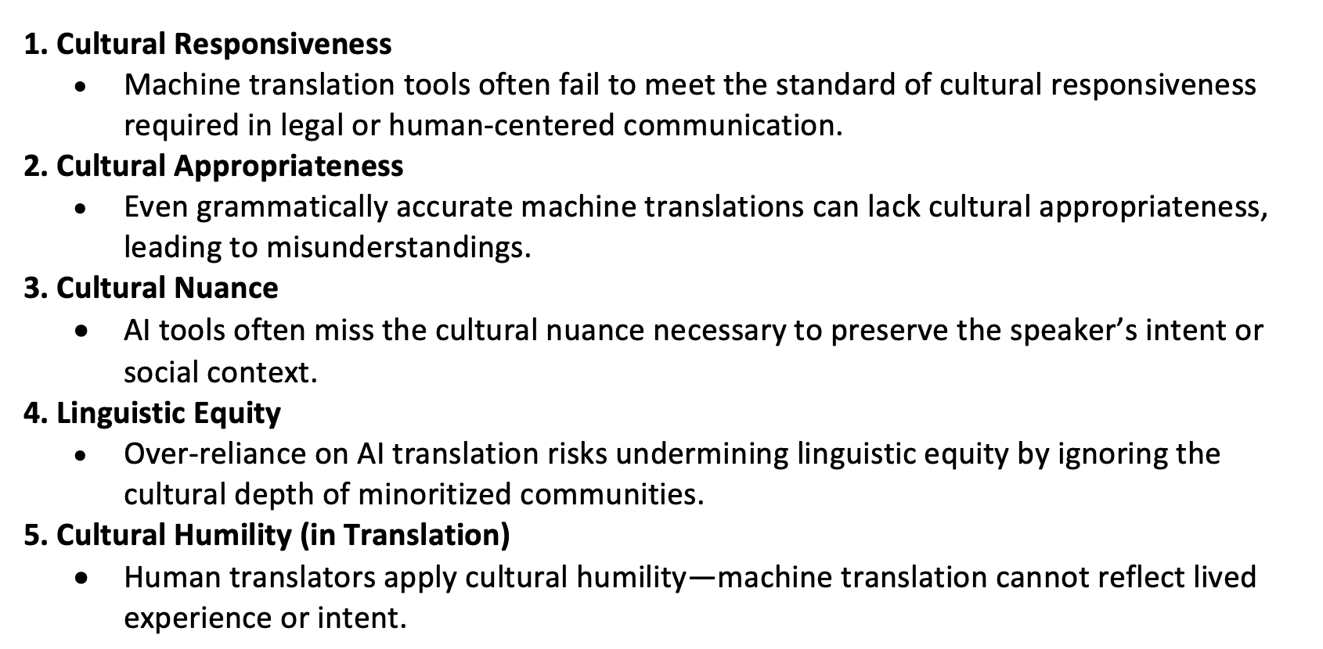
What does ChatGPT have to say?

Slide 22
Questions?
Thoughts?

