Slide 1
Notebook LM
Google’s Virtual Research Assistant
Notes:
To make mouse more visible: Annotate (pencil icon) in tool bar while sharing, spotlight button, red circle
_______________________________
Hi everyone. For those just joining us, my name is shellie Reid, and I am the manager of LSNTAP the host of today’s activities. I want to take a few moments to share Google’s note taking and research assistant tool called NotebookLM. This tool is powered by Gemini AI. But instead of searching Gemini’s knowledge base , NotebookLM’s search is limited to the sources that you provide.
Exciting things are still happening with NotebookLM—Just yesterday, google released the mobile app version so you can now try notebook on your phone or tablet. There are some differences in functionality so I still recommend the browser based version for now if you want to take advantage of the “discover sources” web search feature.
As with any generative AI tool, you need to be aware of the terms of service and how your data will be used. Google states that it does not use your data to train its models, but certain personal account users may be subject to human review and data analysis for troubleshooting or abuse detection.
Workspace and Workspace for Education users have more robust privacy protections, with their data not being reviewed by humans or used to train AI models.

Slide 2
What can NotebookLM do?
Summarize long documents
Learn complex material
Create action items from meeting notes
Writing assistance
Contract analysis
Content creation
Notes:
Link: https://notebooklm.google/
NotebookLM can be used to create a Study Guide, a briefing document, a list of Frequently Asked Questions, a timeline, and most fun of all, a podcast style Audio Overview. You can even choose from 50 languages for the results.
Google suggests that Notebooks can be customized to work as a virtual research assistant, a personal tutor, a shared knowledge-base/help center, and more.
Once created, Notebooks can be shared. Once shared, you can see the analytics.
Audio Overviews: NotebookLM can generate audio conversations about your uploaded documents, presenting information in a podcast-style format. This feature is available in over 50 languages.
Briefing Documents: Create concise, well-organized summaries of your uploaded content.
Study Guides: Transform your materials into interactive study guides with questions, answers, and citations.
FAQs: Organize your information into a frequently asked questions format.
Timelines: Visually represent sequential information, making it easier to understand the progression of events.
Table of Contents: Generate a structured outline of your uploaded content.
Summaries: Ask NotebookLM to summarize specific topics or the entire source directly in the chat.
AI-Generated Chat: Engage in a conversational interface with the AI, posing questions and receiving answers grounded in the uploaded material.

Slide 3
A Historical Timeline of Ferrets and their Roles
Detailed Timeline of Events
Pre-History:
24 to 38 million years ago (Oligocene epoch): Early mustelids, the family that includes ferrets, existed on Earth.
Ancient History:
Around 2,500 years ago: Analysis of mitochondrial DNA suggests that ferrets were domesticated.
450 BC: Ferrets were mentioned in Grecian plays.
425 BC: The Greek word íktis, Latinized as ictis, appears in Aristophanes' play "The Acharnians," potentially referring to ferrets, polecats, or mongooses.
Cast of Characters
Aristophanes: Greek playwright who used the term íktis in 425 BC, possibly referring to ferrets or similar animals.
Strabo: Author who described the use of a Libyan animal, likely a ferret, for rabbit hunting in the Balearic Islands between 63 BC and 24 AD.
Pliny the Elder: Roman author who mentioned ferrets being used to hunt rabbits between AD 23 and 79.
St. Isidore of Seville: Scholar who mentioned ferrets being used to hunt rabbits in AD 600.
Genghis Khan: Ruler of the Mongol Empire, reported to have used ferrets in a gigantic hunt in 1221.
Notes:
I think one great feature is the ability to create a Timeline. With the timeline you can curate a list of events and a cast of characters. Think about this for a complex case and how handy it would be
One thing you need to know about me is that in law school, I had a blog called Ferreting out Justice. And it was a great joy to me whenever ferret appeared in cases.

Slide 4
What sources can I use?
Digital materials
Websites
YouTube videos
Internet search results
Text pasted from a document
Notes:
Google has made it very easy to add and remove sources. And you can have up to 300 sources per notebook.
Accepted File formats include PDF, .txt, Markdown, Audio (e.g. mp3) and more
For non-legal topics, I love to Use the discover button to do an internet search to find resources.
I will demo how to create a notebook later, but the basic Steps are
Load sources and let NotebookLM do its thing.
Once your sources are loaded, NotebookLM generates a summary and names the Notebook and you can start creating notes or other output.

Slide 5
The Dashboard
Notes:
Here, we are seeing the NotebookLM dashboard for my notebook called the Comprehensive Ferret Guide.
As you can see, The screen is divided into three sections: Sources on the left, Chat in the middle, and Studio on the right.
Sources may be a bit obvious, but basically it contains all of the materials that you have added for notebook to use for answers. The chat section functions in the same way as any other generative AI chat and you can see the overarching summary of the materials in the notebook. Here, youcan Type in a question and get a response in the same way as any other Large language model.
The Studio on the right is where saved output is stored. It is also where the controls for generating things like the study guide or FAQ are found and the Notes area is where generated materials can be viewed.
If you especially like any output materials, they can be converted to a source material.
I really like the clean and simple display and The 3 dot kebab elements make it easy to navigate the space.
Please note the red box at the bottom of the screen, Google so helpfully reminds us that Notebook LM can be inaccurate and to double check its responses. As with any generative AI, you must check. So often we hear about AI hallucinating cases—but hallucinations can be other things also—I have had generativeAI hallucinate a book title, a website, ingredients in a recipe, and more.

Slide 6
Look closer
Notes:
Before we move on, I want to point out a unique feature in the chat section.
Just below the notebook summary there are some buttons. The “Save to Note” button allows you to save the summary in the Notes over in the Studio column. But scroll down a bit more and you will see an option for a Mind Map.
As much as I love the audio overviews, I might like the Mind maps more.

Slide 7
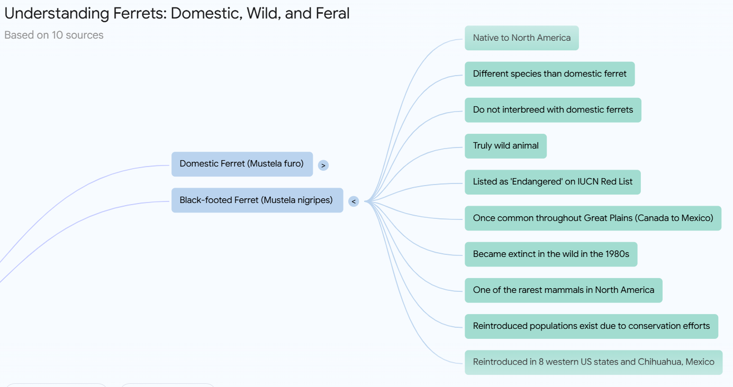
Mind Map
Notes:
in NotebookLM mind maps are visual summaries of your sources, and they show the main topics and the related ideas in a branching diagram.
As someone who mapped out cases in Excel, I really like this feature a lot.

Slide 8
ABA Formal Opinion 512
Notes:
Now, I want to let you hear an example of an audio overview. We’ll just listen to a snippet and then I will drop the link in chat if you want to listen to the whole thing.
This is an audio overview of the ABA Formal Opinion 512.
Listen
I told you that things were still happening in Notebook. Now, an interactive mode in Beta testing allows audio overviews to be questioned just as you might question our speakers today.
__________
Share computer sound under More
https://youtu.be/4IEgoAUaqzU
_______________________________________

Slide 9
What do we want to know?
Notes:
Now, its time to get a bit hands on. I need some suggestions for a notebook?
The chat conversational style and response length can be customized a bit using preset options or using a prompt.
https://notebooklm.google.com/?_gl=1*wyloxh*_ga*ODA1Njk1ODUyLjE3NDc2NzEyNDM.*_ga_W0LDH41ZCB*czE3NDc3MTM2NjEkbzIkZzEkdDE3NDc3MTU4MzYkajQ5JGwwJGgwJGRBQ1A3Y2h3bmhVTjhfZmN6ZXdwVE5EdU9VcXRuY2x3OUZn

Slide 10
Your Turn
Notes:
Link: https://notebooklm.google/

